Slide 1
End of On-The Job Training (OJT) Report
Steven Nanda Kurniawan
IT Development Program Batch-03
Digital Non Retail
Digital Delivery & Operation

Slide 2
Introduction about my Division
Unit : Digital Non Retail
Division : Digital Delivery & Operation
Mentor : Pak Rifqi Riadhi

Slide 3
6-Month On-The-Job (OJT) Training Journey
Monitoring and Maintenance of Production Apps
Monitoring and Support Maintenance in RDN(Rekening Dana Nasabah)
Participate and contribute in Initiative Project
MBI ScriptScheduler Project
Digital Lending Initiative Project (React Native)
eBizLoan Project
Training and Events
SME DL Delivery Inception Agile Workshop from GreyAmp
Joined 1st DRP
Git Workflow and Branching Strategy Workshop from GreyAmp
Dynamo Engine Training with Maybank KL

Slide 4
Initiative Project
MBI ScriptScheduler Project
Digital Lending Initiative Project (React Native)
eBizLoan (Digital Lending) Project

Slide 5
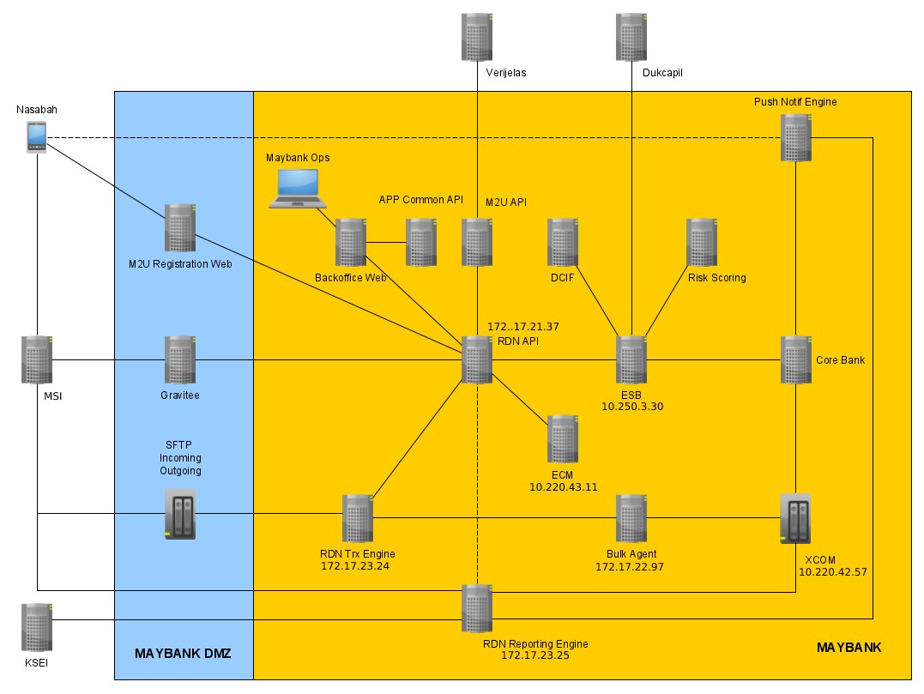

Monitoring and Support Maintenance in RDN Backend(Rekening Dana Nasabah)
RDN is Rekening Dana Nasabah that used for Transaction in Maybank Sekuritas
Tools Used :
Spring Boot
Postgre SQL

Slide 6



Initiative Project (1) – MBI ScriptScheduler
During OJT period I collaborated with my division unit and created Logger to File for ScriptScheduler MBI.
Tools Used :
OracleDB
Spring-Boot
Thymeleaf

Slide 7
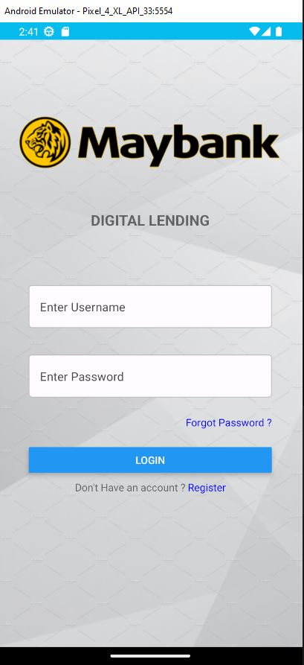
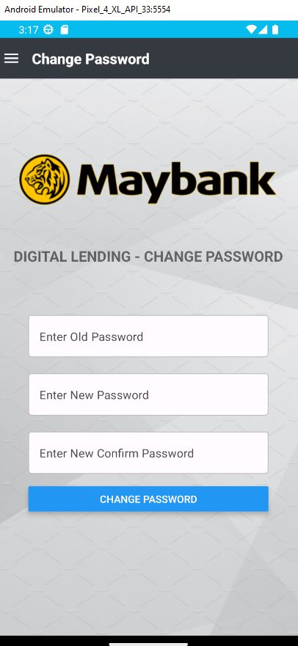
Initiative Project (1) – Digital Lending Iniative Project (React Native)
During on the On-The-Job (OJT) training period I learn React Native by making Prototype for Digital Lending named eBizLoan now
Tools used:
MySQL Database
React Native
Android Studio

Slide 8
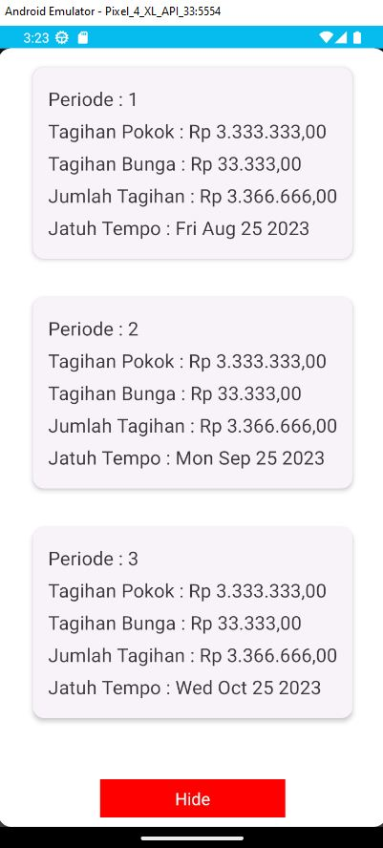
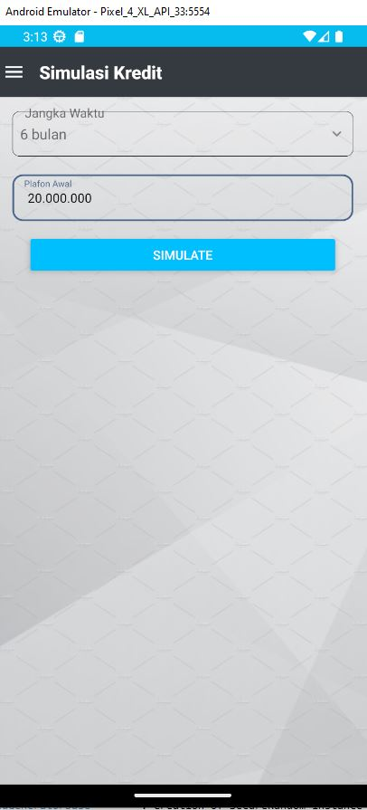
Initiative Project (2) – Digital Lending Iniative Project (React Native)

Slide 9
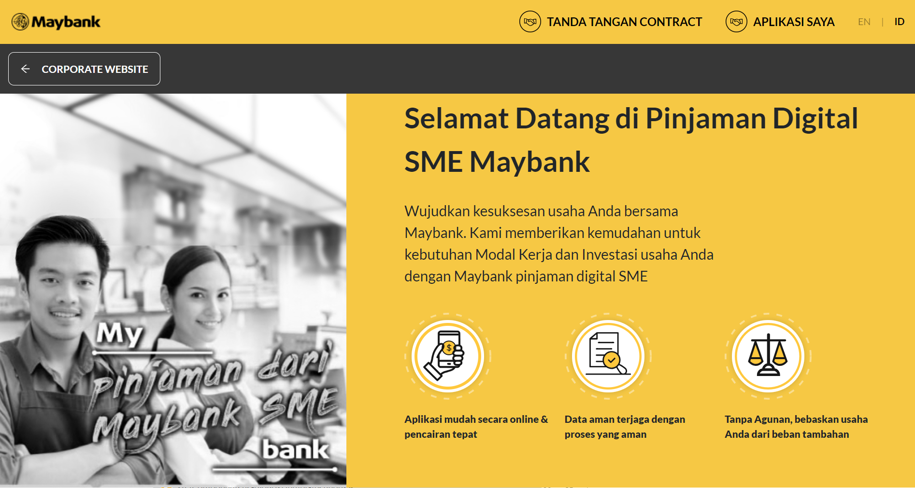

Project (1) – eBizLoan (Digital Lending) Project
During OJT period I collaborated with my division unit member and created eBizLoan.
Tools Used :
OracleDB
Spring-Boot
React JS

Slide 10
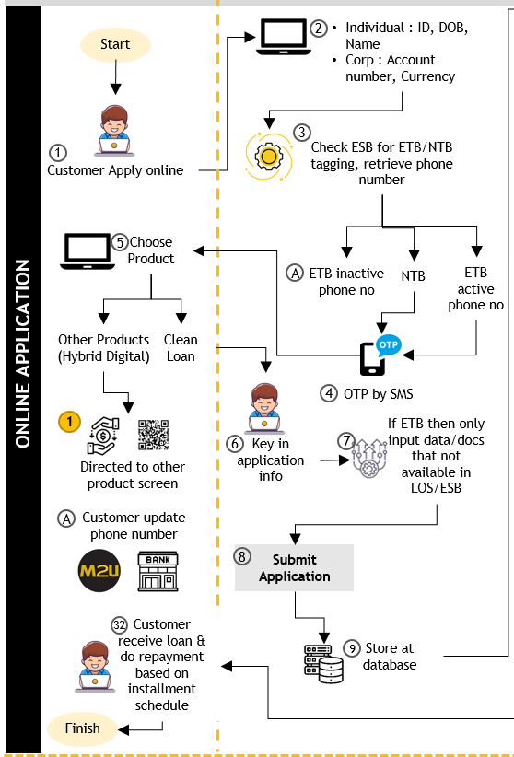
Project (2) – eBizLoan (Digital Lending) Project

Slide 11
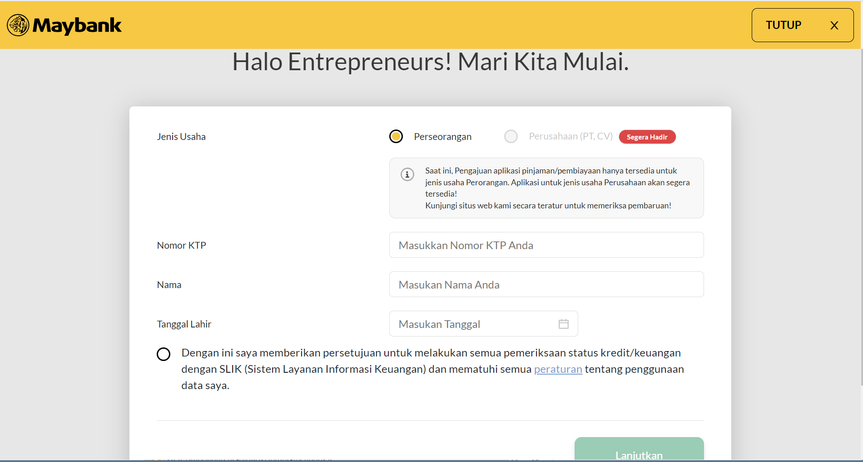
Project (3) – eBizLoan (Digital Lending) Project
Role:
Front End Developer
Tools:
Visual Studio Code (IDE)
React JS
Dynamo Engine
Cypress

Slide 12
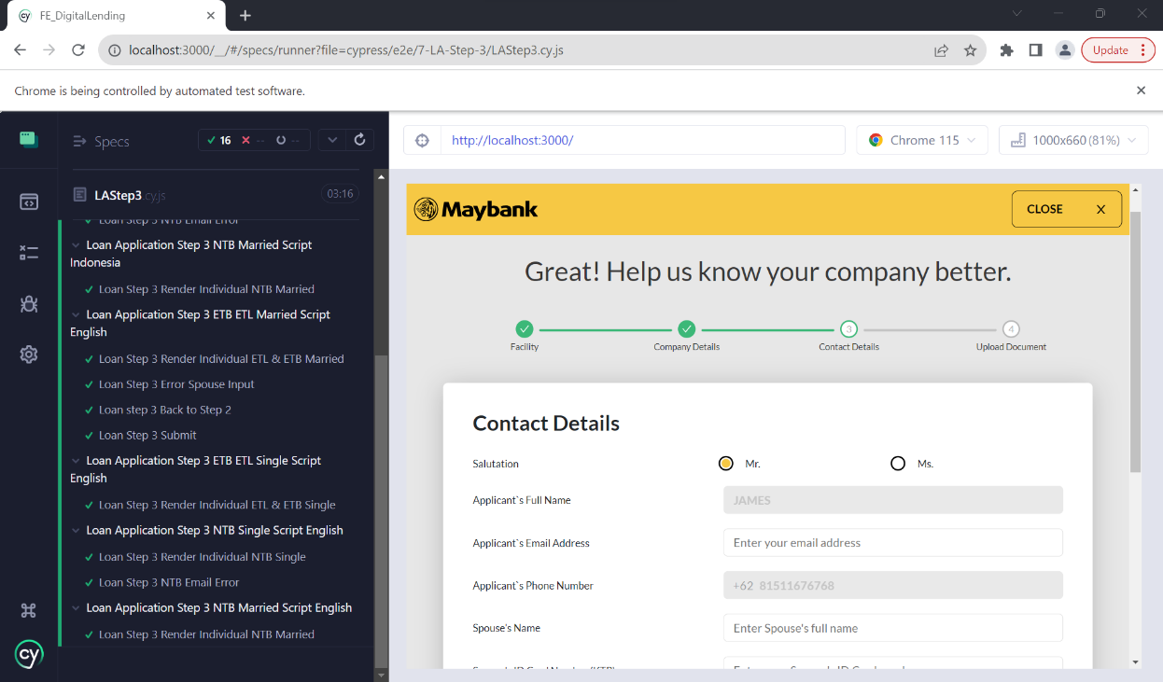
Project (4) – eBizLoan (Digital Lending) Project
Front End unit Testing

Slide 13
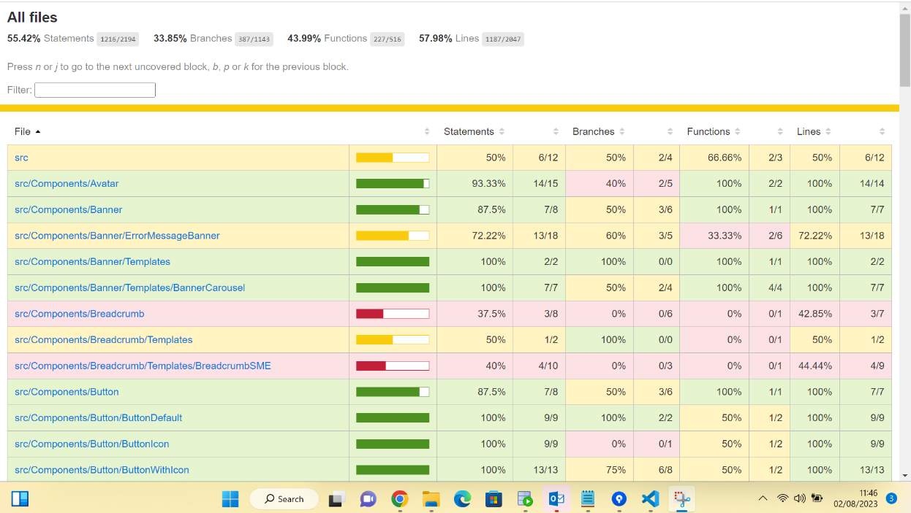
Project (5) – eBizLoan (Digital Lending) Project
Unit Testing Result (Code Coverage)

Slide 14
Initiative Project – Short Demo
eBizLoan Project
http://10.230.84.50:9000/

Slide 15
Output From On-The-Job Training (OJT)
Managed to gain understanding regarding technology that is used in banking industry through mentor and various workshop.
Attained live hands-on exposure regarding the internal system that is used by Maybank with provision of mentor and teammates.
Managed to gain experience working in banking project.

Slide 16
Improvement Ideas (1)
eBizLoan Application Story Planning must be consistent and clear

Slide 17
Big thanks to my awesome team !
My Mentor Pak Rifqi
Digital non Retail Team
Human Capital Team for Coordinating OJT Program
And all Maybankers who helped me throughout my journey

